Slide 1
FOSSID SCAN

Slide 2
INTRODUCTION
The Fossid scan is useful to scan the checked in code which is sent to Gerrit review, to see if it contains any GPL contents or Apache licensing code. Based on the results it will indicate success or failure.
Once a user commits the code in Git and push the code for Gerrit review, we want to check if the code contains any GPL contents or Apache licensing code. This whole process is triggered with a Jenkins build job https://rdkjenkinsdev.stb.r53.xcal.tv/jenkins/job/Fossid-scan-clone/

Slide 3
WORK FLOW
Once the Gerrit review is triggered, the Fossid scan Jenkins build job is automatically triggered. Internally, the fossid plugin looks for the fossid.properties file on the Jenkins server and executes the steps according to what is configured in the properties file .
We are getting the Gerrit patch set and saving it in a file on the Jenkins server and copying it to the fossid server to a specific location.
The Fossid server will scan the Gerrit patchset revision and provide the results in the JSON format. Based on the results match_type: none / partial we decide it is a successful/ failure respectively.
These results are being displayed to the user on the comments section of the Gerrit review URL
The Fossid-scan label is also being updated with -1 or +1 based on the scan results. We are not blocking the merge based on the fossid-scan label at this time.

Slide 4
SUCCESSFUL SCENARIO
Once the user pushes the changes to Gerrit and a review is being created. The Fossid build job is being automatically triggered. If they are no GPL content or Apache licensing code then it sends a match_type none in the scan results and the Fossid-scan label on the Gerrit review is marked as +1 with a successful comment on the Gerrit review.
Steps to reproduce:
vi file.c
→Add all the necessary code and save the file
→git add –all
→git commit –s
→git push origin HEAD:refs/for/stable2

Slide 5
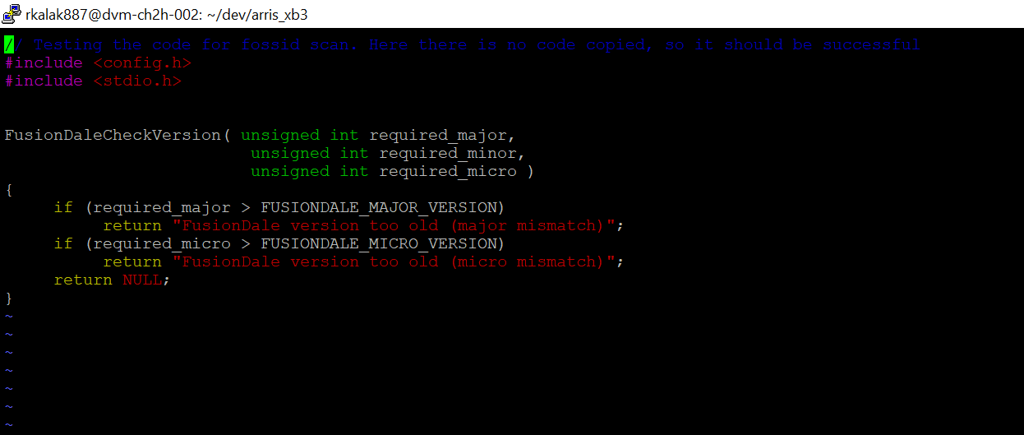
Create a file and save it

Slide 6
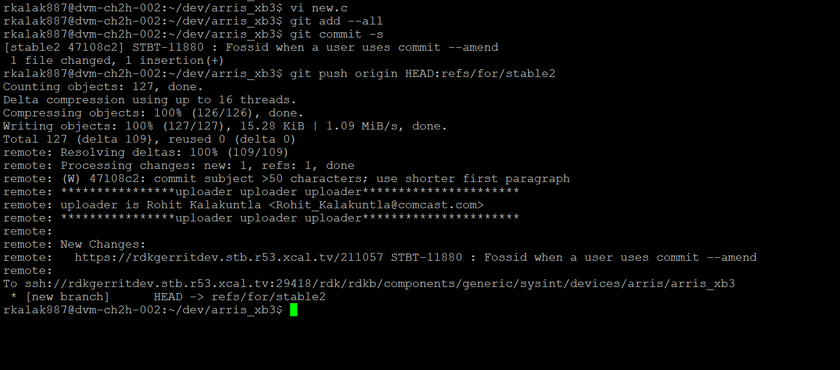
Push the changes

Slide 7
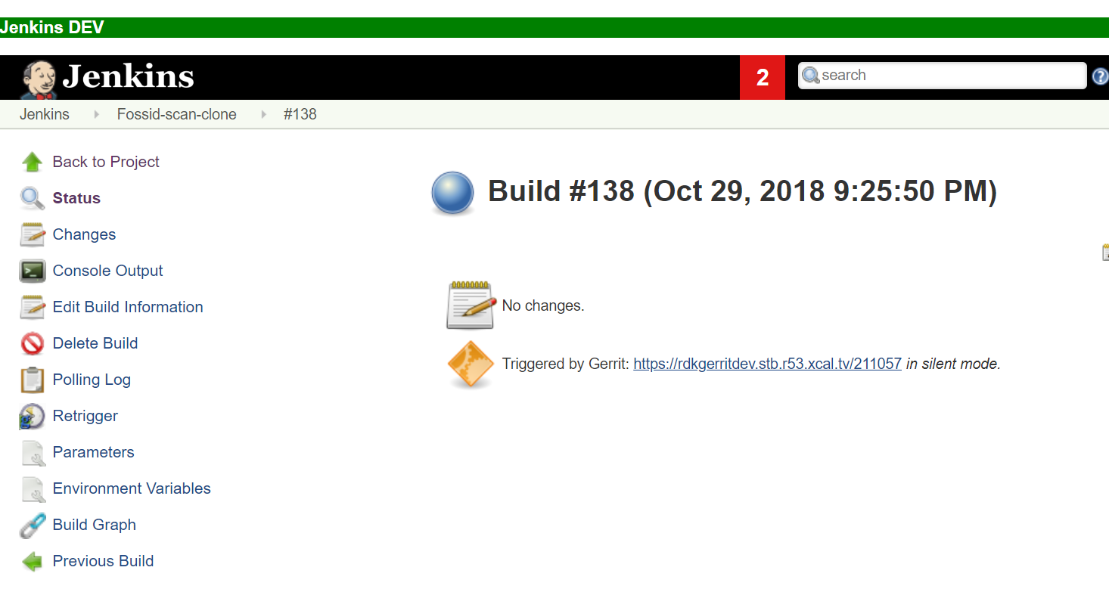
Here the Gerrit review created is https://rdkgerritdev.stb.r53.xcal.tv/211057
The Jenkins build job has been triggered

Slide 8
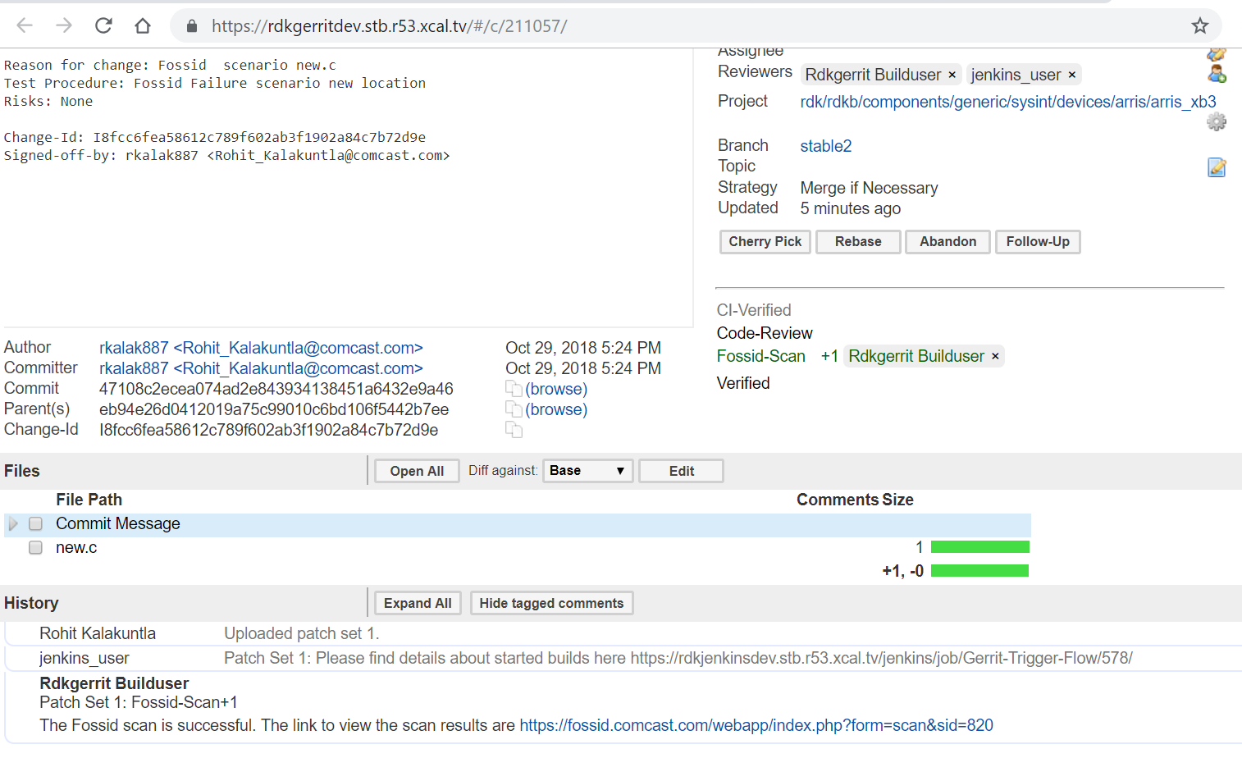
The scan results are being sent to Gerrit review. The URL in this case was
https://rdkgerritdev.stb.r53.xcal.tv/211057.

Slide 9
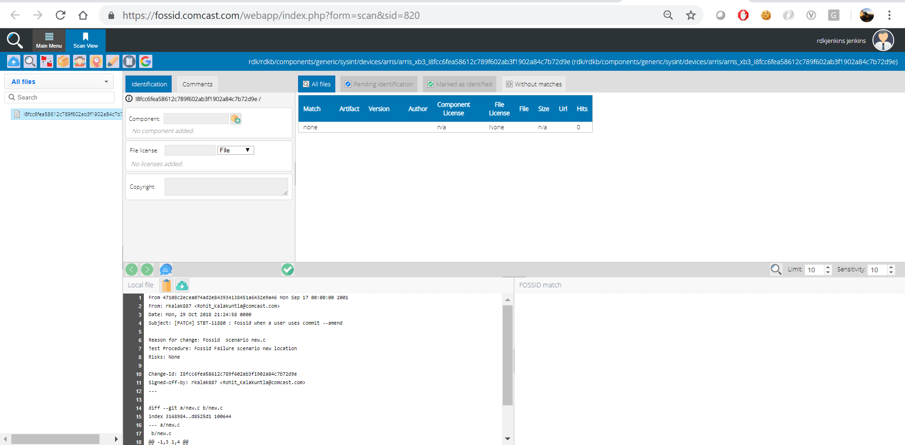
Here we see the Fossid-scan label +1 and also in comments “The Fossid scan is successful. The link to view the scan results are https://fossid.comcast.com/webapp/index.php?form=scan&sid=820”

Slide 10
FAILURE SCENARIO
Once the user pushes the changes to Gerrit and a review is being created. The Fossid build job is being automatically triggered. If they are any GPL content or Apache licensing code. If it finds them in the code then it sends a match_type partial in the scan results and the Fossid-scan label on the Gerrit review is marked as -1 with a failure comment on the Gerrit review.
Steps to reproduce the scenario:
→vi file.c
→ Add all the necessary GPL code or apache code and save the file
→git add –all
→git commit –s
→git push origin HEAD:refs/for/stable2

Slide 11
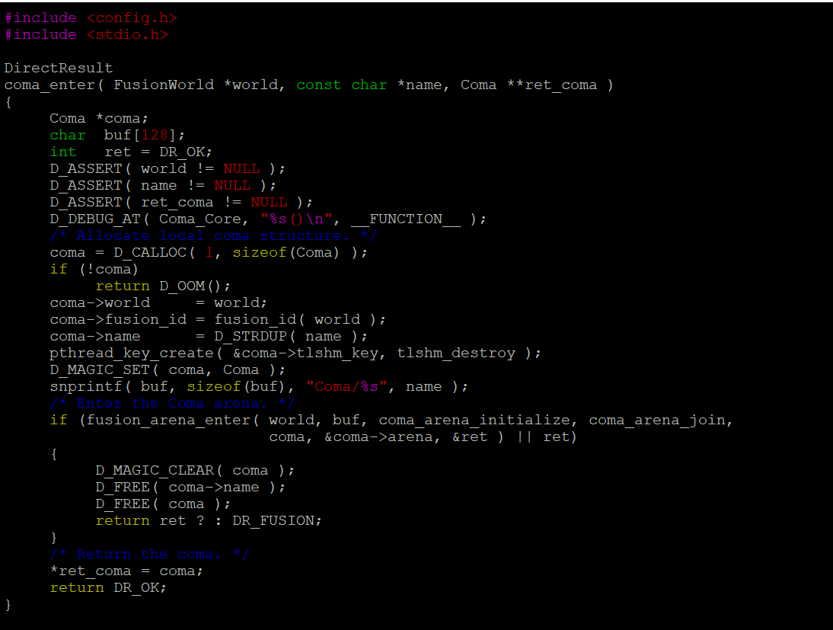
Create a file and save it

Slide 12
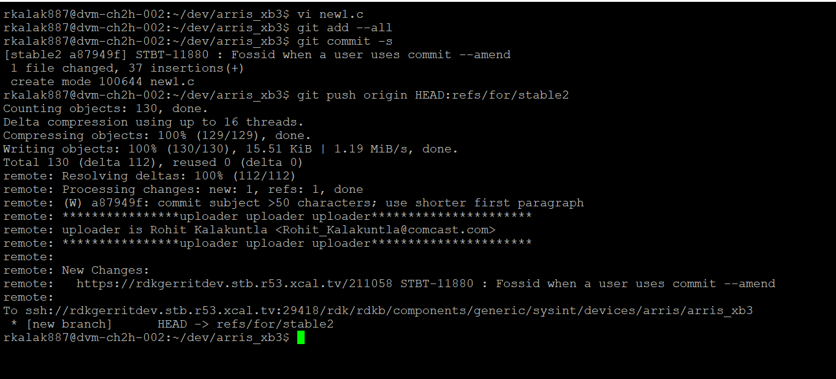
Push the changes

Slide 13
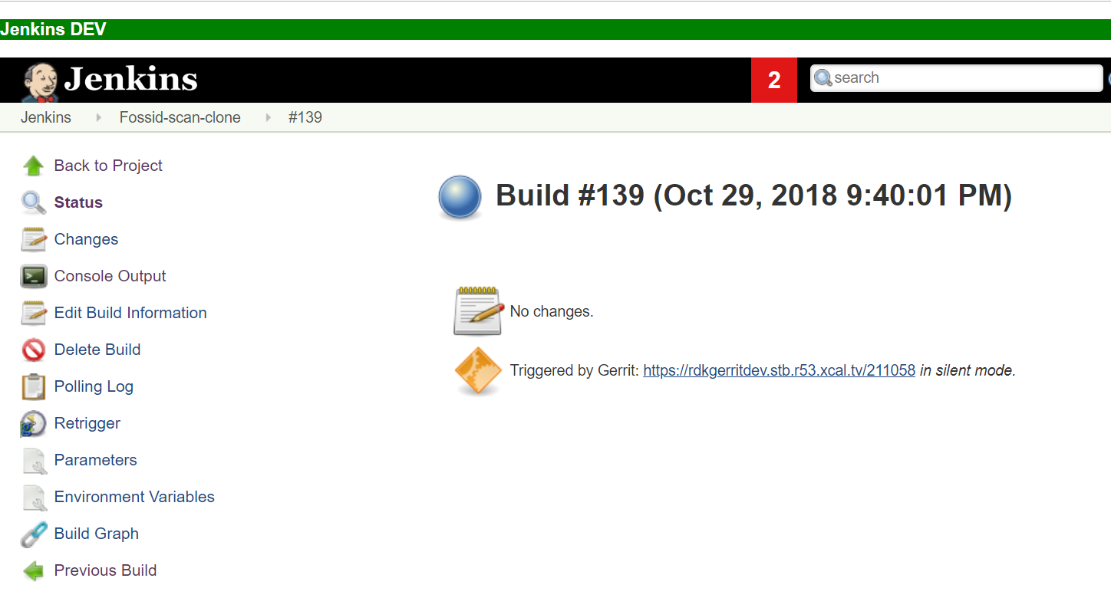
Here the Gerrit review created is https://rdkgerritdev.stb.r53.xcal.tv/211058 and
The Jenkins build job has been triggered.

Slide 14
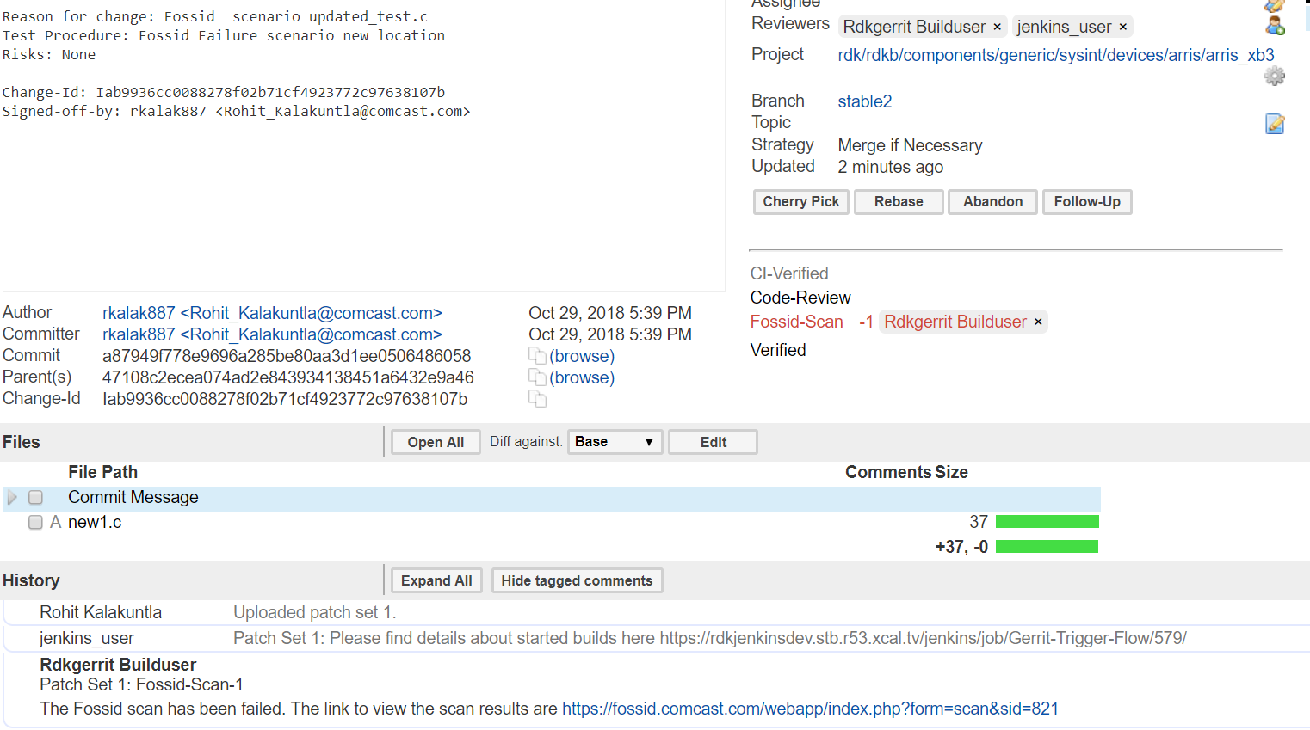
The scan results are being sent to Gerrit review. The URL in this case was
https://rdkgerritdev.stb.r53.xcal.tv/211058

Slide 15
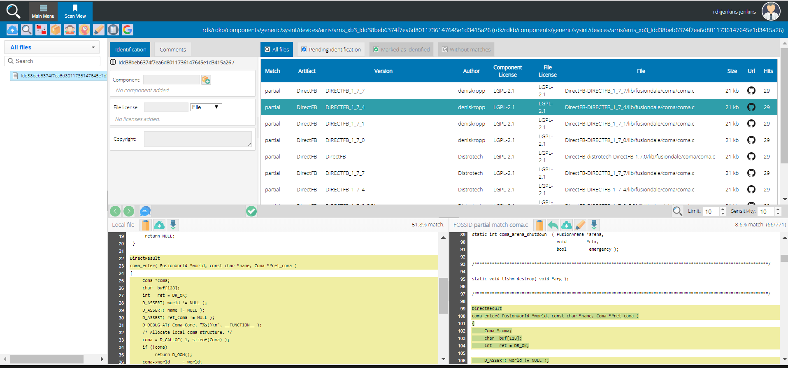
Here we see the Fossid-scan label -1 and also in comments “The Fossid scan has been failed. The link to view the scan results are https://fossid.comcast.com/webapp/index.php?form=scan&sid=821”
It is displaying the code from which it has been matched and what part code has been matched

Slide 16
CORRECTING A FAILURE SCENARIO TO MAKE IT SUCCESSFUL
Once the user is aware of the reason for Fossid scan failure, he has to correct it and update the committed code accordingly.
The user in this case will do a git commit –amend so it will be updated in same review id.
When user pushes the new changes to Git repo, an event will be triggered and initiate the job on Jenkins server.
The scans are being executed on the committed code on the Fossid server.
The scan will check if there is any licensed code in the patch. If there are GPL contents or Apache licensing code committed, then it finds the match in the scan results.
A Scan results will be sent by the Jenkins job to Gerrit. If it finds a GPL content it will fail again or if there is no GPL content it will be a success. The results will be displayed on the Gerrit review in comments section.
The Fossid-Label is updated to +1 or -1 based on the success or failure respectively

Slide 17
Steps to reproduce the scenario:
→vi file.c
→ Update all the necessary code to avoid the GPL code or apache code and save the file
→git add –all
→git commit --amend
→git push origin HEAD:refs/for/stable2
The same review will be updated as it the amend. But a new scan will be taken plan with the updated Gerrit patchset revision.

Slide 18
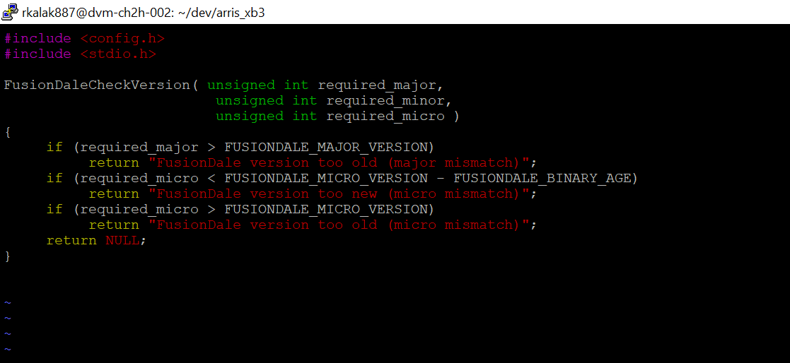
Updating the file which contains the GPL code and making necessary changes and saving it.

Slide 19
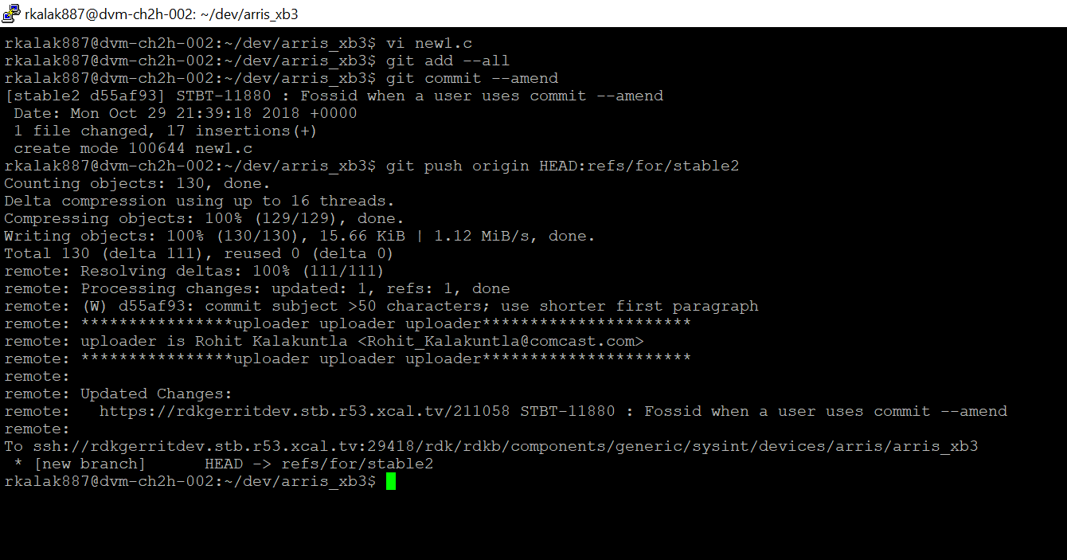
Amend the changes

Slide 20
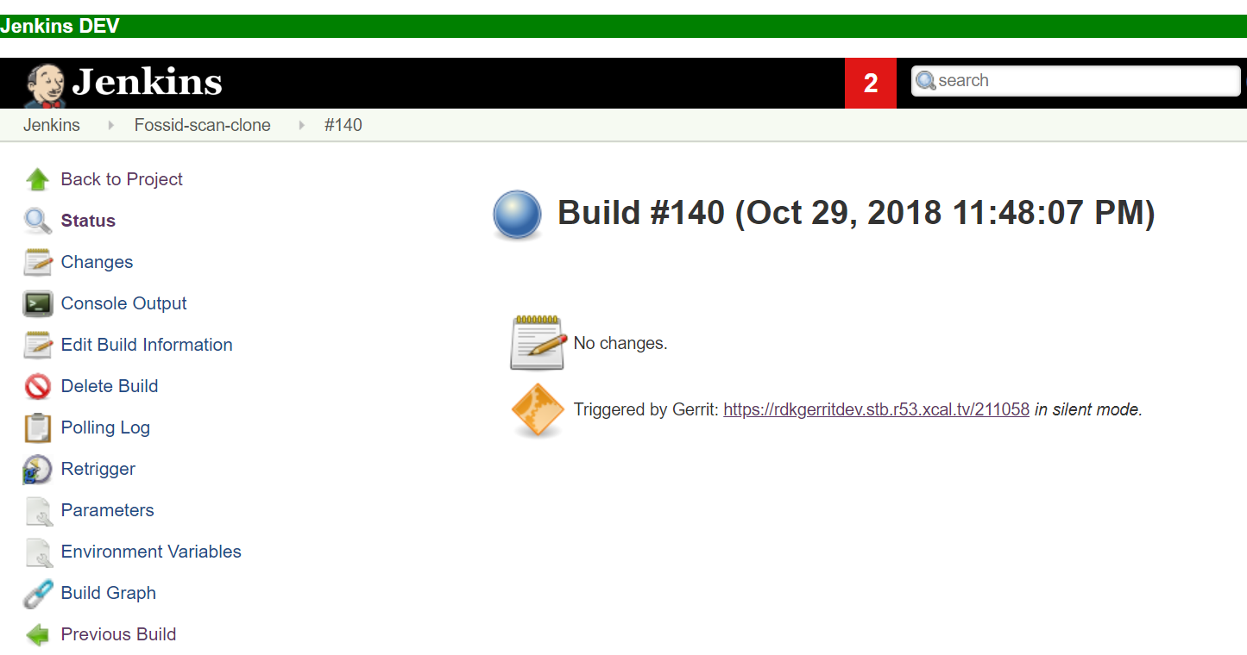
Here the same Gerrit review has updated https://rdkgerritdev.stb.r53.xcal.tv/211058 and
The Jenkins build job has been triggered.

Slide 21
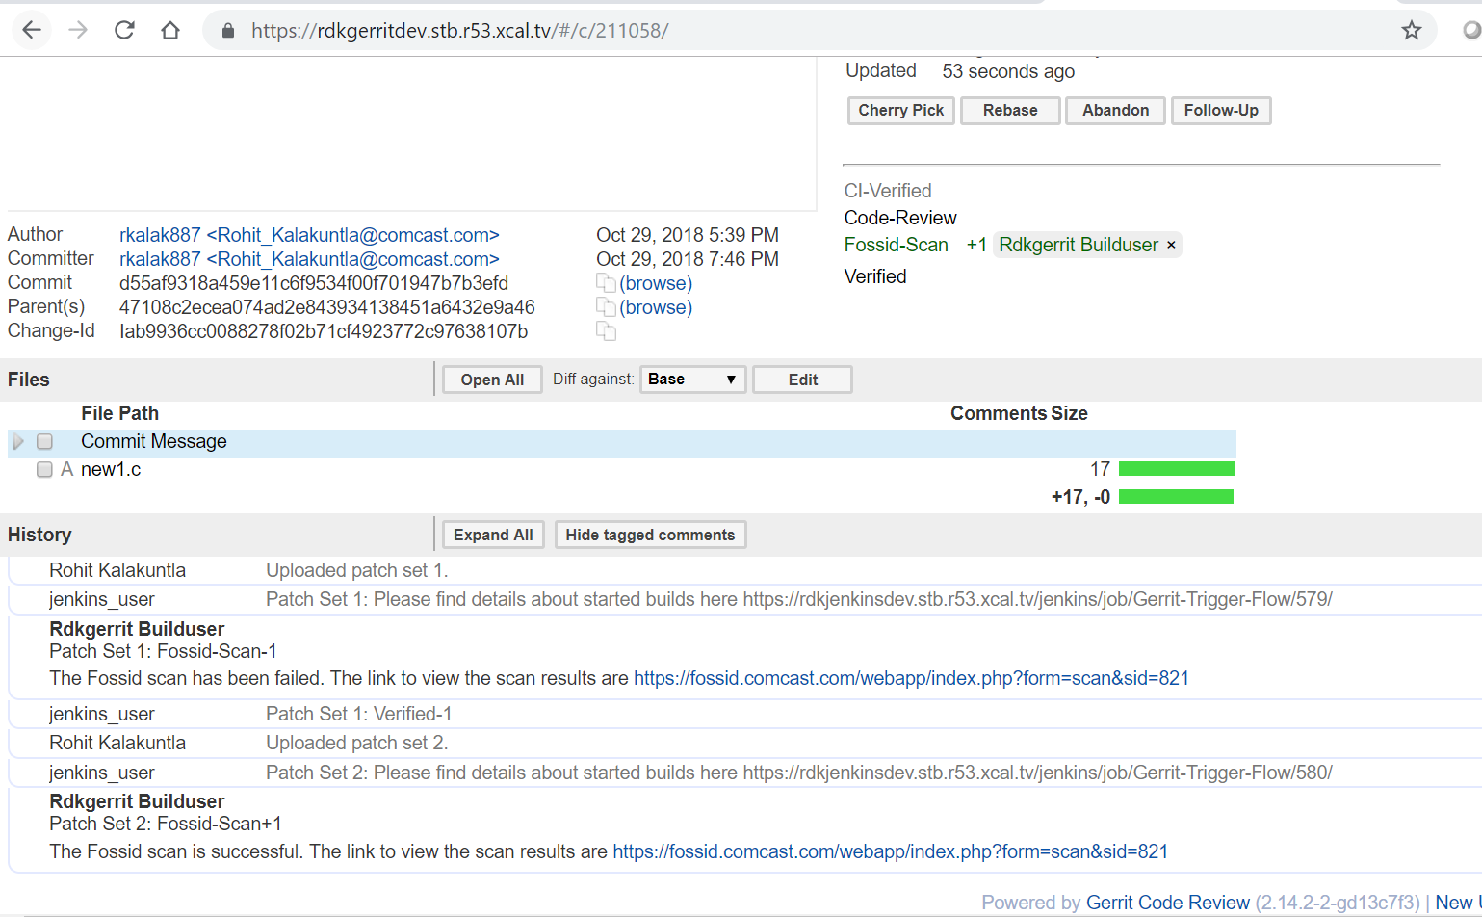
The scan results are being sent to Gerrit review. The URL is the same because we have done a git amend https://rdkgerritdev.stb.r53.xcal.tv/211058

Slide 22
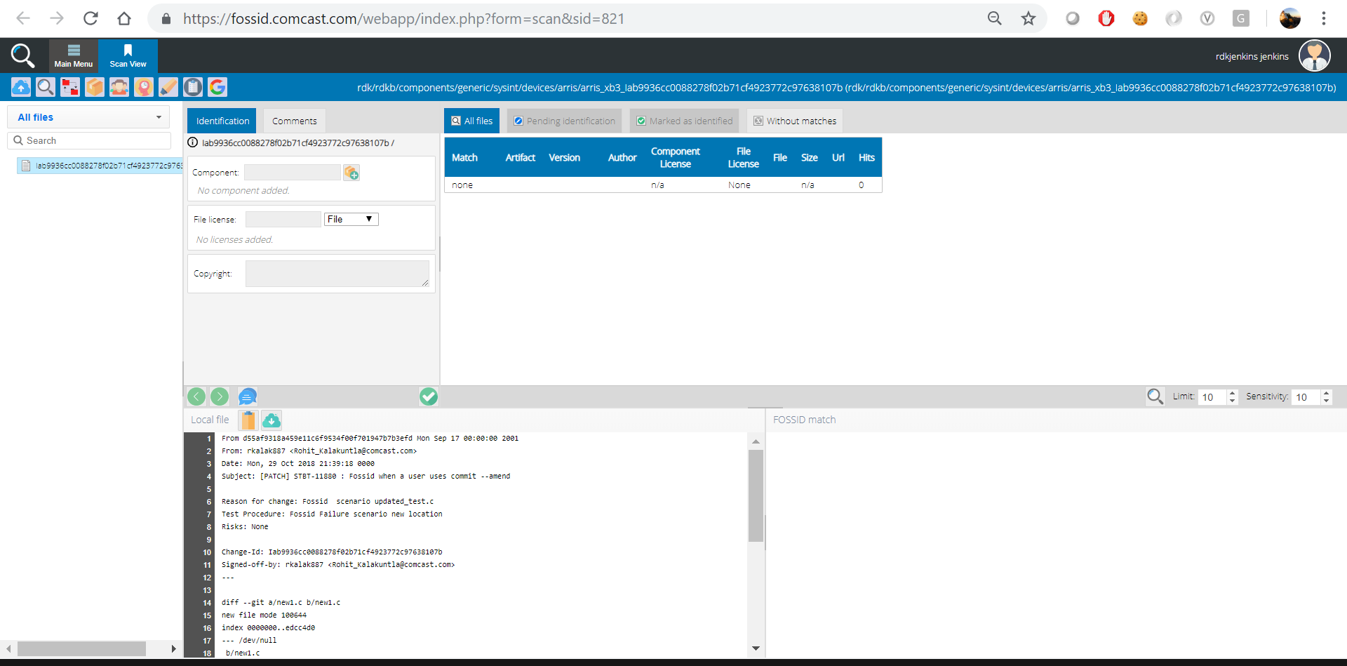
Here we see the Fossid-scan label +1 in the same Gerrit review and also in comments “The Fossid scan is successful. The link to view the scan results are https://fossid.comcast.com/webapp/index.php?form=scan&sid=821” This is the same scan id for the same Gerrit review.

